Slide 1
Mental Health and Schools link Pilot
The Anna Freud Centre
The Anna Freud Centre
@AFCevents

Slide 2
Establishment of a named point of contact within specialist children and young people’s (CYP) mental health services and a named lead within each school
Development of a joint training programme for named school leads and specialist CYP mental health services

Slide 3
Pilot jointly funded and led by NHS England and Department for Education.
22 pilot sites across England: 26 CCGs and 255 schools.
340 Mental Health professionals
570 Education professionals
Aims:
To test how training and joint working can improve local knowledge and identification of mental health issues and improve referrals to services
Improving joint working between school settings and CYP mental health services
Developing and maintaining effective local referral routes
Testing the concept of a lead contact in schools and CYP mental health services

Slide 4
Notes:
This project is funded by Dfe and NHSE.
The training has been developed by experts from a range of academic and health institutions.

Slide 5
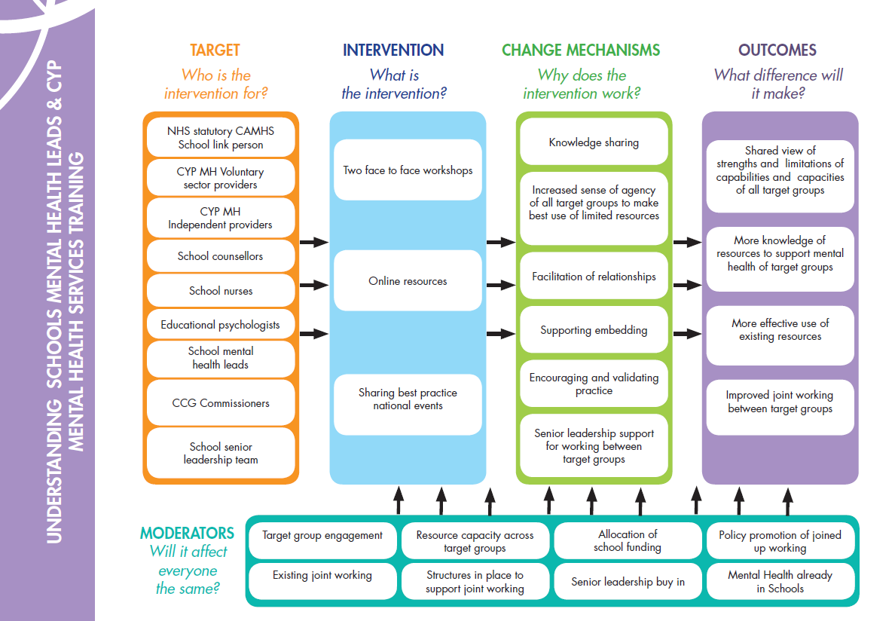
Notes:
You should all have this in your handout packs
Realise this might look overwhelming at first glance – it is just a diagrammatic way of trying to capture what we trying to do with who and how
Orange column – shows who the initiative is aimed at
all the people we are bringing together as part of this initiative, hopefully these are all represented in this room [talk through groups briefly]
Blue column – shows what the programme involves
P1 and P2 involve a mixture of face-to-face facilitation with access to online resources inbetween to support focused joint working
P3 will involve national events to share learning and best practice
Purple column – shows the outcomes/impact we are aiming to achieve through this initiative
these outcomes are not about more knowledge, or about more resource – they are about working as effectively as possible with the limited resources available in your local area [talk through list briefly]
it is about shared understanding of what people can do and can’t do
greater knowledge of the resources available
effective use of these resources and improved joint working
We know this won’t be a magic wand – it is about making small practical changes
These outcomes are focussed on impacts for this programme – however these may lead in time to improving individual achievement outcomes for CYP
Green column – shows what we think is going to help this happen
these are our hypothesised mechanisms, the ways we think facilitation and joint working can lead to the outcomes in the orange column [talk through list]
These things are crucial to help us all achieve our target outcomes
Turquoise box – shows things that can impact on the success of this
things we know from research and evidence make a difference to the likely success of this sort of change process
for eg, how much everyone engages in the process, when existing joint working is there, whether there is enough resource, the extent to which there are structures already in place, whether there is SLT buy in…
[go through list]
All impact on how much impact this workshop will have

Slide 6
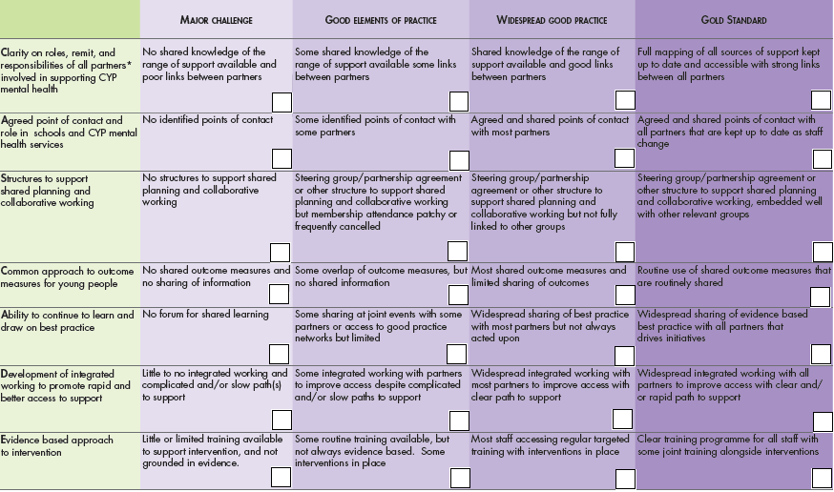
CASCADE Framework

Slide 7
Clarity on roles, remit, and responsibilities of all partners˟ involved in supporting CYP mental health
Agreed point of contact and role in schools and CYP mental health services
Structures to support shared planning and collaborative working (e.g. single point of access)
Common approach to outcome measures for young people
Ability to continue to learn and draw on best practice
Development of integrated working to promote rapid and better access to support
Evidence based approach to intervention

Slide 8
Evaluation
External - Ecorys
Internal

Slide 9
External Evaluation
Notes:
Final report expected Nov 2016

Slide 10
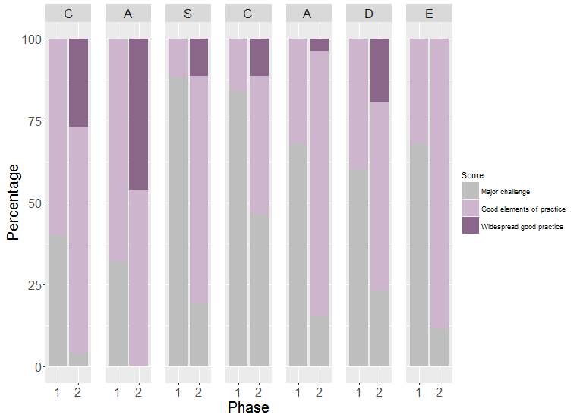
Attendee CASCADE ratings at Phase 1 and Phase 2

Slide 11
Feedback on Sessions
Notes:
Note: From survey B

Slide 12
Joint working and knowledge of resources

Slide 13
The workshops were great, bringing us together with local schools and giving us the opportunity to network and hear their issues, including details of the challenging behaviour that they’re experiencing. The workshops really encouraged and reinforced the type of thinking that was already underway in our CCG.
Commissioner
As a new member of staff to specialist CAMHS this has been a very valuable opportunity to review current provisions, web resources, consider service issues and hear about projected service planning.
CAMHS Professional
This is an opportunity for CCGs and schools to work together more closely, trial a new way of thinking and a new model. Our aim is to significantly improve the care and experience we can offer to children and young people with mental health problems.
Dr Jackie Cornish, National Clinical Director for Children and Young People at NHS England

