Slide 1
One year on from Future in Mind
Peter Fonagy, National Clinical Lead for CYP IAPT
Kathryn Pugh, Children and Young People’s Programme Lead
Anne O’Herlihy, Project Manager CYP IAPT and the Children and Young People’s Team, NHS England

Slide 2
My ‘take home’ message
A lot has happened, but there is still so much to do
We need to keep the focus now on implementation of Local Transformation Plans, including integrating them with whole system Sustainability and Transformation Plans
We need to maintain support to keep all partners engaged – children and young people, families, schools & colleges , health, local authorities, voluntary sector
More evidence based treatment pathways are coming
The work you are doing on data and outcomes is vital to the mainstreaming of CAMHS as core business

Slide 3
Number of mentions of children’s mental health in UK newspapers 2008-2015
1000
800
600
Children’s Mental Health
Mentioned at least once
400
200
2008
2009
2010
2011
2012
2013
2014
2015
Years
Source: Lexis Nexis
Notes:
3
The profile of children and young people’s mental health has never been higher
In 1990 not a single mention and only 9 in 1995 vs 996 in 2015

Slide 4
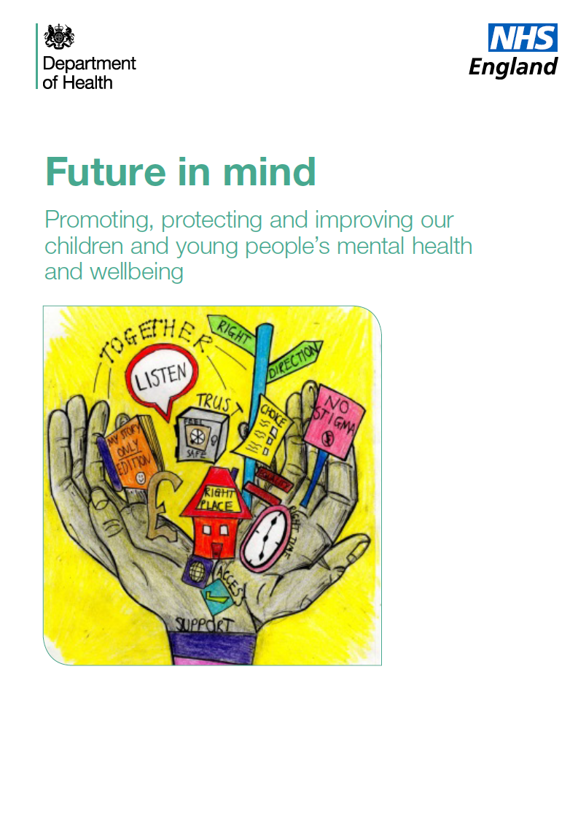

Notes:
Future in mind set out a clear vision for improved mental health support for children and young people
It established a clear and powerful consensus across health, education and social care
This priority remains and has been endorsed by the Five Year Forward View for Mental Health,
The key themes of each review are aligned and compliment each other.

Slide 5
Future in Mind and the Five Year Forward View
Some key common themes
Promoting resilience, prevention and early intervention
Improving access to effective support
Care for the most vulnerable
Accountability and transparency
Developing the workforce
Promoting good mental health and preventing poor mental health
A 7 day NHS – right care, right time, right quality
Complex need services nationally from 2016
‘Hard-wiring’ mental health across the NHS
Notes:
Quote from the correct document

Slide 6
Future In Mind and the FYFV for Mental Health
By 2020, for people of all ages we want to see:
More visible and accessible support
Improved transparency, leadership and accountability across whole system
Improved crisis care for all ages: right place, right time, close to home
Improved public awareness less fear, stigma and discrimination
Timely access to clinically effective support
More evidence based, outcome-focused treatments
Better use of data and information across the network
And for children and young people specifically:
Improved access for parents to evidence-based programmes of intervention and support
Model built around the needs of children and young people, and a move away from the ‘tiers’ model
Professionals who work with children and young people trained in child development and mental health
A better offer for the most vulnerable children and young people
Publications Gateway
Ref. No. 03250
Notes:
The five year forward view recommends that Future in mind is delivered in full
It also makes further important recommendations relevant to CYP, including:
Better crisis care for all ages – available 7 days an week
Much better use of data and information across agencies
Addressing inequalities in mental health care
The roll out of proven community forensic CAMHS and complex need services nationally from 2016
A new generic referral to treatment pathway for generic CAMHS to be developed in 2016-17
A payment system by 2017-18 to drive whole system to improve outcomes that are of value to CYP and parents/carers
Integrated regulation of CYP services to assess how health, education and social care systems work together to improve outcomes

Slide 7
Local Transformation Plans
All CCGs submitted Local Transformation Plans (LTPs) on time
123 plans covering 209 CCG areas
Assurance determined monies going out to all CCGs by End December
Spend to be tracked in Q3 and Q4
Plans in user friendly format on web by 31st December 15 – had to include baseline data
Continuous tracking of use of funds in further years to be part of routine assessment process
LTPs should be refreshed, republished each year and included in Sustainability and Transformation plans

Slide 8
Transformation plans should
Be Transparent – publishing:
Baseline investment by local commissioners
What services are provided including workforce information
Referrals received, accepted, waiting times
Demonstrate Service transformation in line with principles covering
Range and choice of treatments and interventions available;
Collaborative practice with children, young people and families and involving schools;
Use of evidence-based interventions; and regular feedback of outcome monitoring to children, young people and families and in supervision.
Monitor improvement
Development of a shared action plan and a commitment to monitor, track and review improvements with appropriate governance structures.
Notes:
What did we ask of our community ?
We asked for plans that allow us to be transparent
How much money is spent? On what? And to what effect
Are local areas changing to deliver services in line with the principles and values of the Cyp IAPT programme – evidence based, outcomes focussed, collaborative
How will we know we are getting there? We asked local areas to deline KPIs that mattered to them

Slide 9
LTP = a good CYP MH Strategy
Cover the spectrum of services
Including community eating disorder services
Focus on prevention interventions, for existing or emerging mental health problems
Transitions between services.
Include local leadership and governance arrangements
To secure a whole system approach to delivery at local level
Demonstrate collaborative commissioning within and across sectors
To promote effective joint working and establish clear pathways.
This includes working with collaborative commissioning groups in place between NHS England specialised commissioning teams and CCGs
Demonstrate that schools are given the opportunity
To contribute to the development of Transformation Plans.
Be coherent with local priorities
And with the child mental health requirements in the existing joint planning guidance.
Notes:
In essence what we asked for was a good strategy
Covering the whole spectrum
With clear lines of accountability
Improving joined up relationships – the backroom that no one should be aware of but which has such impact if it is not functional
We want to make sure that schools are given every opportunity to join this wholesale transformation
More than anything else, we want this to become business as usual for local areas – CYP MH shouldn’t be special or different, it should be as natural to provide good services as it is to provide A&E For that we need to land CYP MH in the day to day local priorities and commissioning round

Slide 10
Things to celebrate from the LTPs
Complete focus from many local areas with clear leadership
Joined up approach
Understanding of importance of EBP and authentic participation
Focus of strategic players supporting local areas
Raised profile of CYP MH locally and nationally
Creative ideas and energy
Notes:
This was a monumental effort - It was genuinely moving to see everyone come together to plan, to reflect, and the anxiety as well as enthusiasm to do the right thing. I want to say a public thank you to everyone involved in the process, whether as a consultee, a writer, or an assurer. Your contribution is what will move this forwards
There were some particular challenges as you might expect during the planning process not least because of the short time frame

Slide 11
Key challenges for us all
Workforce planning and capacity - across all sectors
Variable leadership, commissioning and collaboration
Joint commissioning – how rather than why
IT planning - need to comply with requirements to be able to flow data and use outcomes in the room
Anxiety about spending the money in the best possible way

Slide 12
Summary of Data Analysis
Expenditure
Approx Total Community and Inpatient CYPMH Expenditure 14/15
Approx CYPMH Community and Inpatient Expenditure by funding source %
CCG
NHSE
£273m
Approx annual NHSE Inpatient spend on CYPMH 14/15
£628m
Approx annual spend on CYPMH 14/15 by CCGs and Local Authorities
LA
46%
38%
16%
Approx Average Expenditure on community and inpatient services per CYP
Average annual CYPMH expenditure per CCG and LA
£78
England Annual CCG Average
£2,721k
England Annual LA Average
£949k
* Population segments used are 0-17 years general population based on latest available ONS data
** Community services in relation to referrals and workforce refers to Tier 3 or Tier 2/3 depending on the data provided by the local CYPMH system.
*** Community and Inpatient services in relation to expenditure includes Tier 2/3 and also NHSE spend on in-patient services (Tier 4)

Slide 13
Summary of Data Analysis
Referrals and Workforce
Approx annual total CYPMH Community Services Referrals 14/15
Approx total annual CYP accepted vs referred into community services per general population 1000 0-17 year olds
Total Referrals
Total Referrals Accepted
18/24
270K
198K
Approximate England Average Community Expenditure per Referral
Approx CYPMH staff in community services per 1000 0-17 year olds
£2,338
Clinical
0.7 WTE
Admin
0.2 WTE
* Population segments used are 0-17 years general population based on latest available ONS data
** Community services in relation to referrals and workforce refers to Tier 3 or Tier 2/3 depending on the data provided by the local CYPMH system.
*** Community and Inpatient services in relation to expenditure includes Tier 2/3 and also NHSE spend on in-patient services (Tier 4)

Slide 14
Summary of Data Analysis
KPIs and Most common transformation priorities
The graph below presents the most commonly used Transformation KPIs that LTP areas will use for monitoring progress of their transformation funding
As a result it is a good basis to view what the most common themes are for transformation funding at a high level.
Eating Disorders is the most common theme and 15% of all KPIs, which is of no surprise as there is a separate funding stream for it. School & Education, Crisis, Digital & Technology projects and General Vulnerable groups are the next most common and make up almost 25% of the total KPIs
It should be noted that these percentages relate only to the number of total KPIs and do not represent overall monetary amounts dedicated to these areas. Additionally, the information collected here was only from the Transformation KPI trackers and as a result does not mean that LTP areas are not addressing these areas in other ways outlined in their LTPs
Total number of KPIs
“Other” includes:
Transition & Discharge
Early Intervention
Self-help
Home (treatment)
Neurodevelopmental
Psychosis
Inpatient / tier 4

Slide 15
Summary of Data Analysis
Most Common KPIs
The following sets some examples of interesting KPIs within the KPI themes (excluding eating disorders)
Improved appropriate referrals to CAMHS
Development of digital apps/e-material to improve self-care, resilience & CAMHS offer
All schools and colleges to have a named mental health & wellbeing lead
Improvement in classroom learning & emotional resilience
Increased awareness & access of mental health services
Increased training & confidence in managing mental health issues
Number of CYP accessing appropriate interventions as part of a coordinated package
Increased number of CYP reaching appropriate level of development
Number of early help assessments
Develop vulnerable CYP outcome measure
Improved access for hard to reach groups
Integrated care pathways & outcomes through IT
Meeting minimum dataset requirements & outcomes monitoring
Use of online counselling
CYP able to access support & interact with consultants/clinicians virtually
2
Vulnerable Groups KPIs
1
School & education
Digital & technology KPIs
3
Please note that there were variations in terms of wording used for similar KPIs. The most common or clear wording has been used above.

Slide 16
Vulnerable Groups Summary Key Facts
% of LTP areas that evidenced current or future plans for particular key vulnerable groups.
85%
77%
76%
71%
69%
58%
Looked After Children or Care Leavers
CYP in crisis
CYP with
complex needs
CYP known to the youth justice system
CYP in transition
CYP at risk
of child sexual exploitation
30%
25%
25%
10%
10%
2%
Referenced 1 vulnerable group categories
Referenced 2 vulnerable group categories
Referenced 3 vulnerable group categories
Referenced 4 vulnerable group categories
Referenced 5 vulnerable group categories
Referenced 6 vulnerable group categories

Slide 17
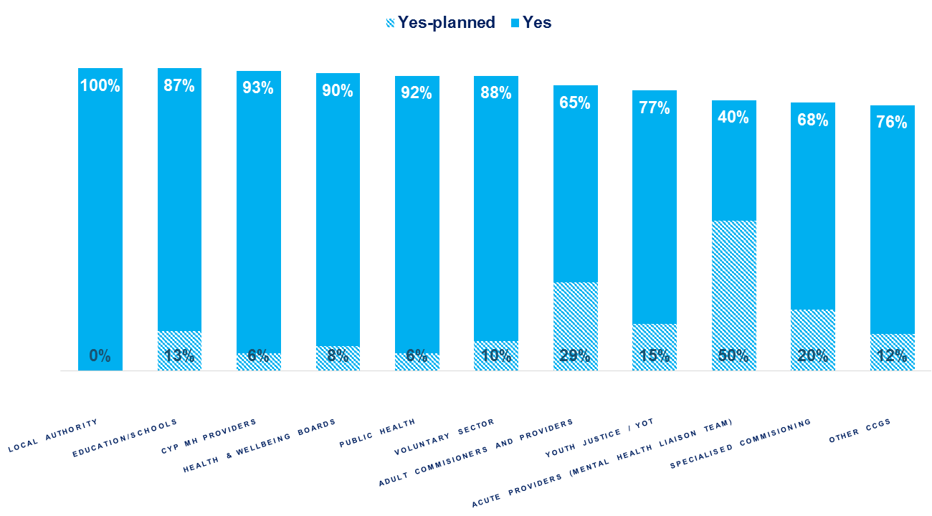
Whole Systems Summary Key Facts
% of LTP areas that evidenced current or future plans for engagement for different organisations groups in the whole system.
Evidence in LTPs

Slide 18
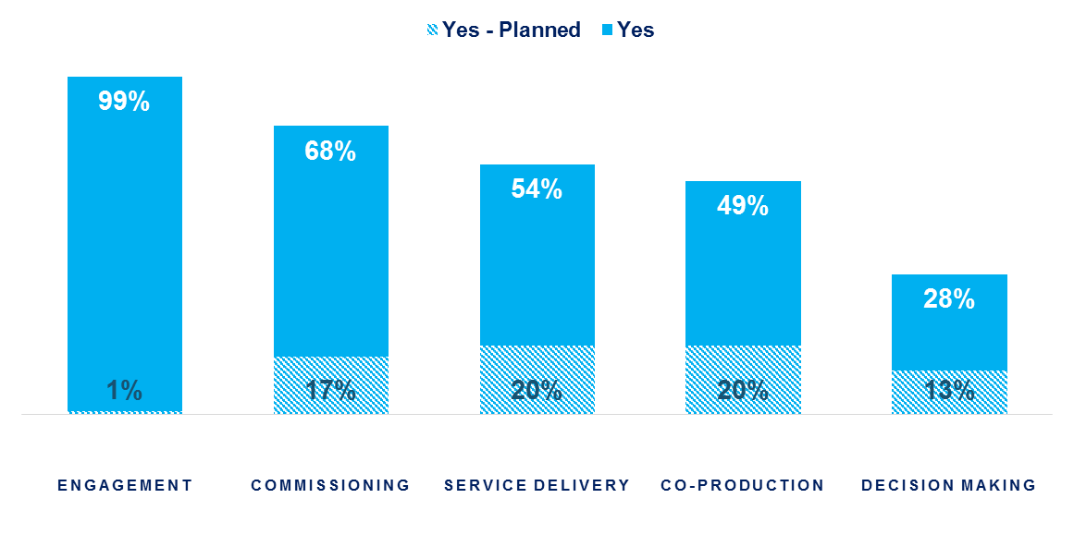
CYP Participation Summary Key Facts
% of LTP areas that evidenced current or future plans in each participation sub theme category
Evidence in LTPs

Slide 19
NHS Benchmarking Report 2015
Data validated with each of the participant organisations
Community CAMHS
  Referrals increased by 11% last year
  Waiting times for non-urgent services have increased significantly, median maximum waits (i.e. the mid-point for the back of everyone’s queue) is now 26 weeks
  Contact levels have increased by 4% in the last year
  DNA rates unchanged at 11%
  Staffing levels have increased by around 2%
  Service costs are similar to 2013/14
Inpatient
  Bed occupancy is 76% excluding leave, lower than most Adult bed types (just Perinatal is lower)
  Inpatient staffing levels have increased by 3% (Safer Staffing has increased inpatient staffing in most specialties in the last year)
  Most quality measures have improved (e.g. reduced levels of violence, ligature incidents, and prone restraint) – however incidents such as violence, restraint and self harm are significantly higher than in the adult sector
  Costs per bed have increased in the last year.

Slide 20
CYP IAPT: expansion (NHS England & HEE)
Continued commitment to embedding evidence based, outcome focussed collaborative service transformation with full participation
Model of delivery is through a collaborative and mentoring scheme between learning collaboratives (HEI) that work in partnership with local providers
Increased geographical coverage of service transformation programme to100 % by 2018
Offer training across partnerships (NHS, LA, Vol sect): CBT, SFP, IPT-A, Parenting, Supervision, Service Transformational Leadership, EEBP, outreach service development, outreach enhanced supervision.
New curricula – evidence based interventions for
Children and young people with learning disabilities or autistic spectrum disorder
Working with 0-5s
Counselling
Combination - Prescribing and therapy
Inpatient CAMHS
National Accreditation Council – assure quality of training and embedding of principles

Slide 21
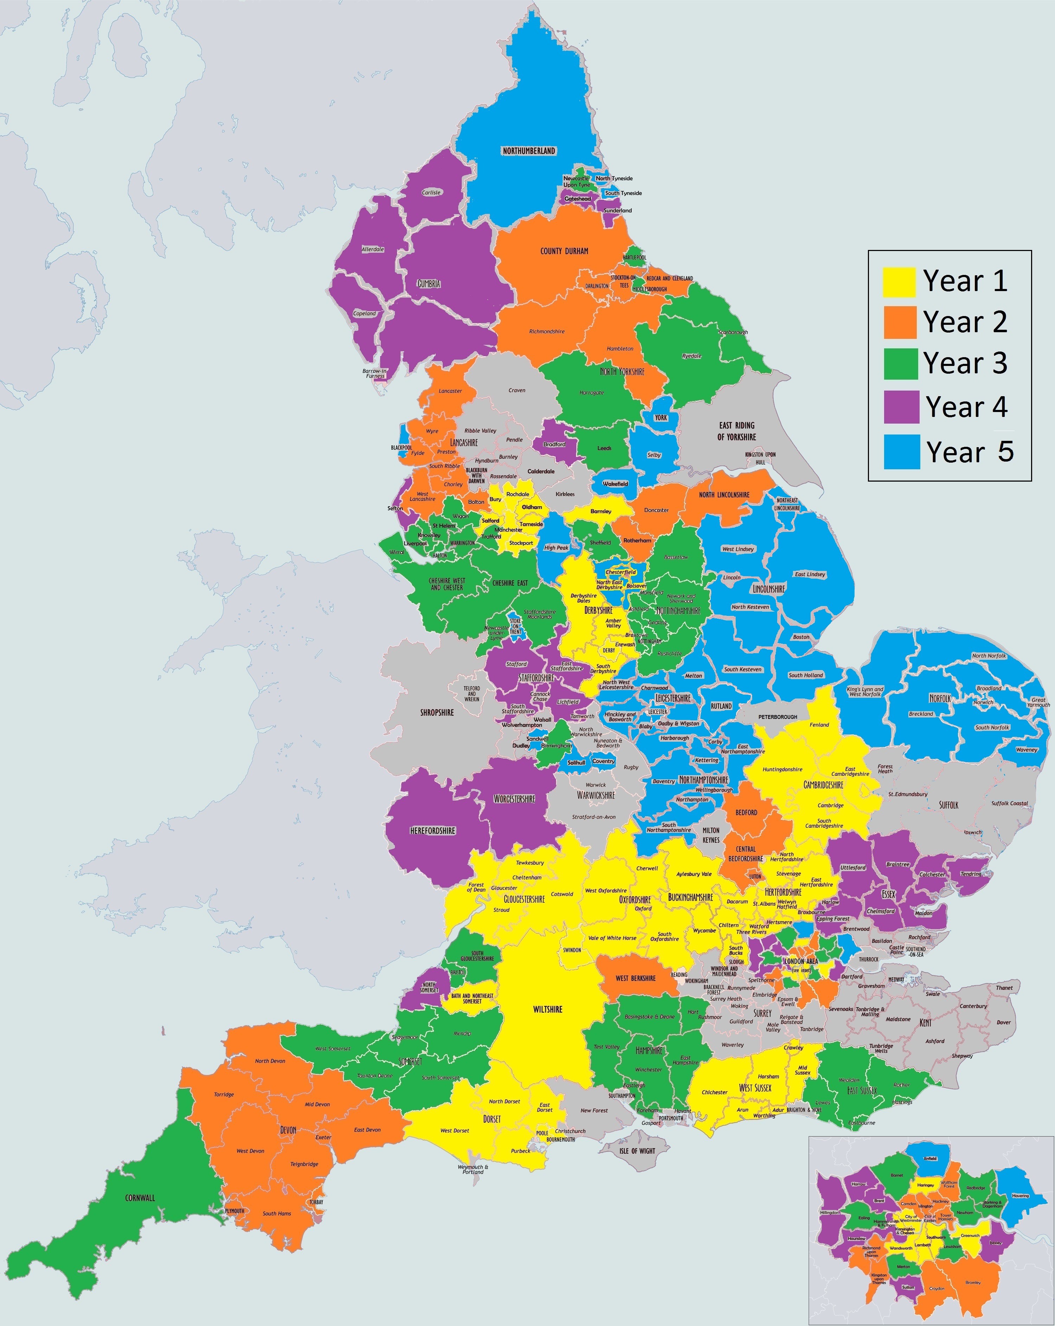
CYP IAPT
Partnerships Map
Following recruitment of 6th collaborative, programme on target to work with services covering 80% of 0-19 population by March 2016.
This goes up to 87% when including ‘light touch’ outreach and service leadership work to prepare partnerships for full modality training

Slide 22
Is it working?
Young people seen more quickly-time between referral and assessment decreased by 73%
YP achieved significant clinical improvement over fewer sessions - number of days between assessment and discharge decreased by 21%
Improved access through self-referral routes, single point of access, outreach services, evening and weekend appointments.

Slide 23
Increased agentive CYP involvement
Greater involvement of children, young people and their parents or carers:
Throughout treatment and every aspect of their care
Recruitment and interview panels
Staff appraisal and training
Website and information design
Planning and delivery of mental health awareness
Mystery shopped service evaluation
Environ-mental changes
Speaking with clinical directors
New feedback systems ‘you said, we did’
CYP agreed they had recovered sufficiently to be discharged - percentage of closed cases by mutual agreement increased

Slide 24
CYP and parent/carer engagement
Young People’s Health Select Committee Report launched November http://www.parliament.uk/business/news/2015/november/youth-select-committee-report/
  Proposals include - parity of funding, joined up system, statutory level of attainment for MH in schools, training for teachers and GPs as well as MH workforce focused work cyberbullying and exam stress
Time to Change anti stigma campaign
www.time-to-change.org.uk

Slide 25
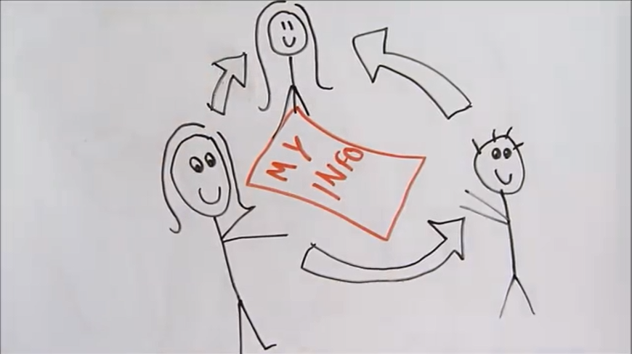
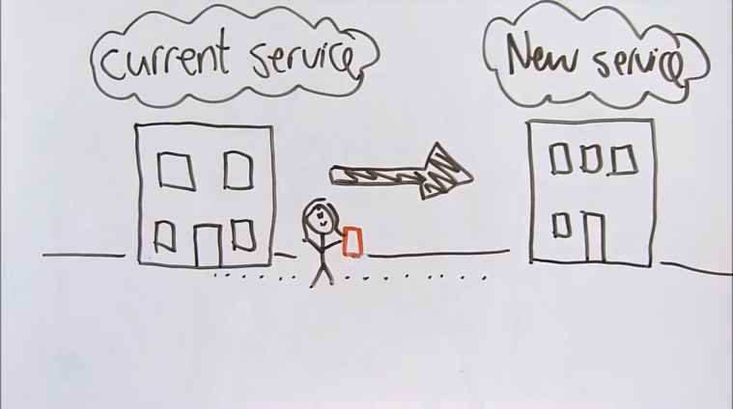
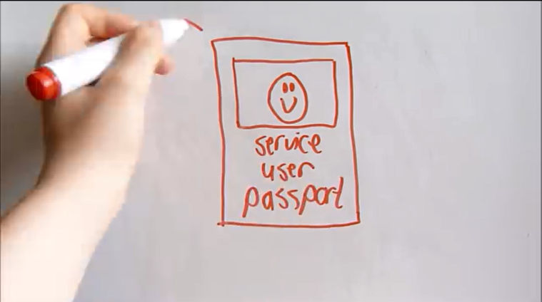
My Mental Health Services Passport
www.england.nhs.uk/mentalhealth/2015/10/15/passport-brief-yp-mh
Developed by young people and parents/carers with NHS England as part of the CYP IAPT programme
The aim of the passport is to help young people using services to own and communicate their story when moving between different services.
The passport provides a summary of young person’s time in a service, for the information will be owned by the young person, and for it to be shared with any future services if the young person wishes

Slide 26

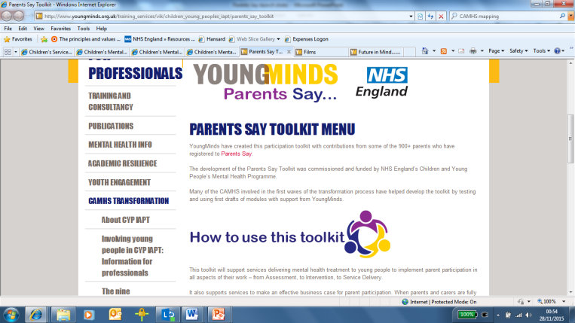
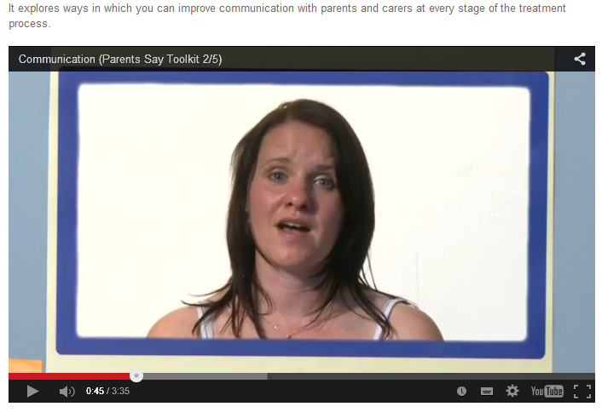
New online resource created for and with parents and carers to help improve mental health care for children and young people
Over 900 parents/carers
identified 5 key areas:
  access, equality and diversity
  communication
  service leadership and delivery
  methods of engagement
  workforce development
Best practice case studies,
videos, resource directory
www.youngminds.org.uk
Notes:
Young Minds – Parents Say: http://www.youngminds.org.uk/for_parents/parents_improving_services
MindEd: www.minded.org.uk
Online resource created for and with parents and carers to support engagement, inform service development, shared feedback and partnership working that will improve delivery of care and outcomes for their children.
Over 900 parents/carers identified 5 key areas for improvement:
Improving service access, equality and diversity by working with parents
The need for greater levels of communication from services
Participation in service leadership and delivery
Diversifying the methods of engagement used with parents and carers
Supporting the workforce development of staff teams
Best practice case studies
Videos
Resource directory

Slide 27

Resources
Resource for all adults to increase awareness and understanding
Includes free e-learning sessions for all those working with CYP (incl. ED sessions)
Currently developing sessions with parents for parents
https://www.minded.org.uk/
DATA:
Chimat and CAMHS ebulletin –http://www.chimat.org.uk/camhs
CORC: http://www.corc.uk.net/
NHS Benchmarking Report 2015
MHSDS-to flow from Jan 2016
GIFT
Sign up for www.myapt.org.uk; see video clips
https://www.youtube.com/user/CernisLimited/videos
Notes:
Young Minds – Parents Say: http://www.youngminds.org.uk/for_parents/parents_improving_services
MindEd: www.minded.org.uk

Slide 28
At the National Level
DH chaired system oversight board – PHE, HEE, LGA, ADCS, DfE, NHS E, CQC , ADPH
Cross cutting board aims to
    develop effective system wide governance arrangements to support and sustain local transformation of mental health services for children and young people.
    support work that either requires or receives significant benefit from joint approach
    information sharing

Slide 29
System wide subgroups
Data and Outcomes
  National metrics, MHMDS, data sharing
Joint work on vulnerable children
Operational group
Vulnerable children
Prevention and Early Intervention
Workforce

Slide 30
Data update
MHMDS first reports from CYP MH published
ALL MH services commissioned by NHS flow data – we need to assist 3rd sector
Prevalence Survey commissioned to report by 2018
Research by DfE into MH spend in schools
Further work by NHSE on Programme Funds
Plan to test currencies next year

Slide 31
Other work streams in NHS England
Tier 4 procurement and further improvements to access beds in a timely fashion – new models of care
Transforming Care - Case managers to support CTRs and EHC plan
DfE shared pilot schools link : 22 sites, 255 schools
Further support for Health and Justice commissioning and liaison and diversion
Eating Disorders - work on training specification for whole team training
Crisis and urgent care – joining whole life groups
Generic pathway standards

Slide 32
Direct support for commissioners
System Dynamic model - final version
Scope Commissioning support training
Refresh specifications published last year
Deliver new specification for Eating Disorders based on guidance
Each access and waiting time standard will include commissioner guidelines

