Slide 1
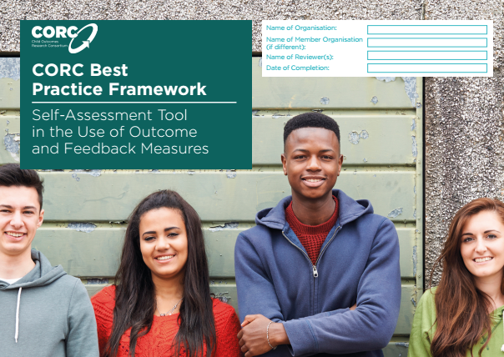
CORC Best Practice Framework:
Self-Assessment
& Accreditation Tool
Alison Ford – Regional Support Officer, CORC
Nicky Martin – Counselling & Psychotherapy Service Manager, YPAS
Claire Ely – Director, Bromley Y

Slide 2
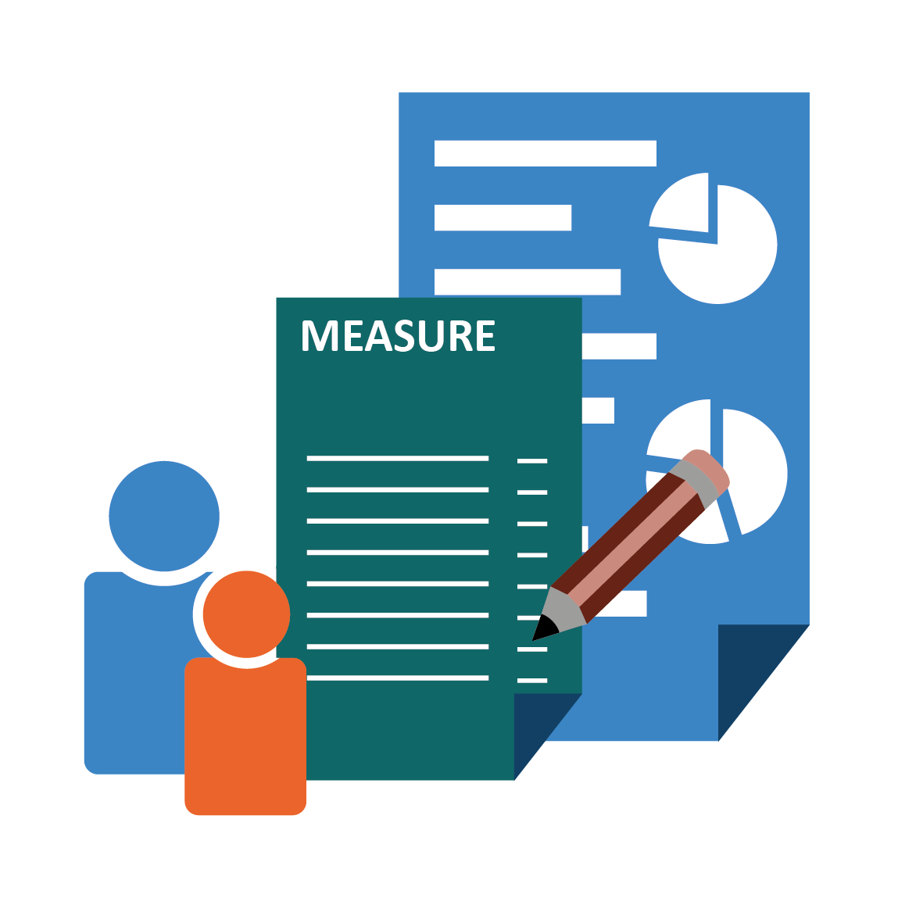
Overview
What is the CORC Best Practice Framework?
Accreditation process
Benefits
Member’s experience
  YPAS
  Bromley Y
Questions

Slide 3

Why?
Routine use of outcome and feedback measures embedded within national guidance
Increasingly important for providers and commissioners to demonstrate good practice in the use of outcome and feedback measures
Limited (if any) guidance previously available about ‘best practice’
Notes:
Future in Mind; Measuring With, Measuring Well;

Slide 4
CORC Best Practice Framework
Developed in 2015; Piloted in 2015/16
Structured process for working towards best practice
Based on evidence to date of what makes for effective use of outcomes and feedback data to inform quality service provision

Slide 5
Approach
Strategically led
A ‘whole system’ process, involving staff across the service and at every level
A collaborative approach which involves children, young people and their parents and carers
Continuous improvement

Slide 6

Structure
4 Themes
16 domains
4 stages of practice

Slide 7
What does it look like?
LEADERSHIP & MANAGEMENT
STAFF DEVELOPMENT
Understanding of different data sources (including measures)
INFRASTRUCTURE AND
INFORMATION MANAGEMENT
Enabling data use in direct practice with clients
SERVICE USER EXPERIENCE
Service user ‘s understanding of measures
Organisational vision
Enabling use of data at practitioner level
Enabling use of data at team level
Enabling use of data at service level
Organisational commitment to collection and collation
Organisational commitment to
interpretation and use
Organisational culture supportive of use and learning
Use of measures
Training and Continued
Professional Development (CPD)
Review of measures and feedback in supervision
Communication with service users about measures
Collaborative setting of goals and choice of measures
Service user’s feedback
on support

Slide 8
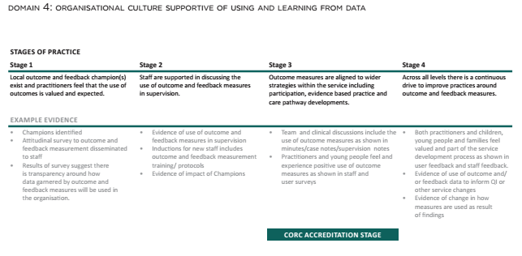
Evidence
Framework includes examples of evidence you might consider for each domain:
Notes:
“Enabling use of data at team level”

Slide 9

Self-Assessment
Whole system assessment of ‘where are we now?’
CORC staff survey
Evidence recorded
Assign & record ‘Stage of practice’ achieved
Determine Action Plan for areas requiring development
Timely implementation
Review

Slide 10
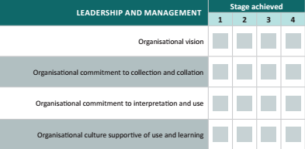
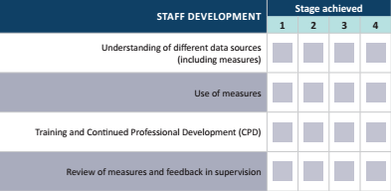
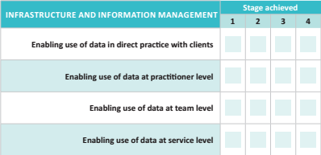
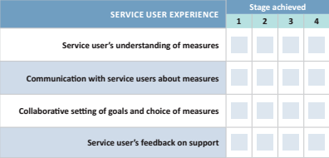
Self-assessment summary

Slide 11
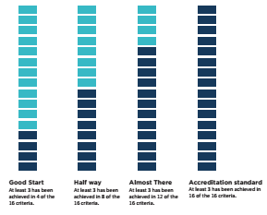
Stepping Stones to CORC Accreditation
CORC Accreditation = at least stage 3 in each of the 16 criteria
Use the stepping stone approach to determine where your service is now, and where you need to get to

Slide 12
Accreditation
Accreditation Assessment:
  Requested by you when you’re ready
  Whole day visit from CORC Accreditation Officers where you present the evidence for your self-assessment; this may include:
    Review & discussion of evidence
    Focus groups/interviews with staff, service users and other key stakeholders
    Observation of practice

Slide 13
Accreditation
Accreditation Report:
  Verbal feedback provided following the visit
  CORC Officer recommends Accreditation (or not!) to CORC Board representatives
  Written summary report sent to service, outlining Strengths and Areas for Development
  Accreditation certificate & ‘CORC accredited’ logo for successful services
  Ongoing monitoring and review expected

Slide 14
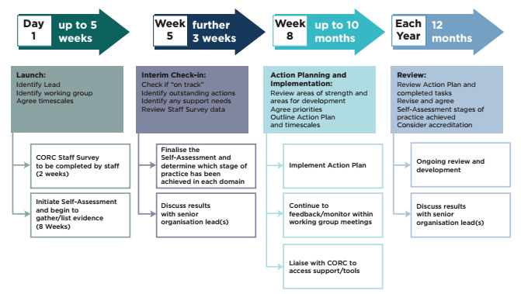
Suggested timeline:

Slide 15
Benefits of Self-Assessment/ Accreditation
Opportunity to involve staff at all levels in self-review and service improvement
Demonstrate good practice to a minimum required standard
Recognition of the quality of your service through a national accreditation system
Demonstrate the quality of your service to young people, parents, referrers and commissioners

Slide 16

Liverpool Partnership
Notes:
CORC membership as a partnership – Alder Hey Fresh Camhs, ADHD F, PSS Spinning World & YPAS

Slide 17
Liverpool Partnership
Liverpool Partnership is a nationally recognised model of best practice
Partnership between statutory and voluntary sector agencies
Developed and embedded over the past 12 years
Liverpool CYP IAPT Partnership (phase 3) is a sub set of the Liverpool CAMHS Partnership

Slide 18

Liverpool Partnership ROMS Workstream

Slide 19
Partnership Approach
ROMs workstream
Competing priorities
Auditing tool
Recognising differences - internal systems
Sharing ideas – in service sub groups
Support and challenge approach - links to leadership
Meeting the criteria – at different stages
Priorities for Action
Notes:
Its really important when focusing on the best practice framework as a partnership to have regular opportunity to meet – the ROMS workstream was that opportunity, supported by both our commissioner Lisa Nolan and Alison we untilised this time to complete the framework together.

Slide 20

YPAS
“Improving mental health and emotional well-being outcomes for children, young people, families and carers in Liverpool
since 1966”
Notes:
Charity Established in 1966 , supports children, young people, families and carers. We have 3 locations in Central, South and |North Liverpool.

Slide 21
YPAS
YPAS – YIACS
YPAS team – culture of measurement
Best practice framework – opportunity to reflect - room for improvement
Progression
Trust in the relationship with CORC
Where is our evidence?
Solidifying processes

Slide 22
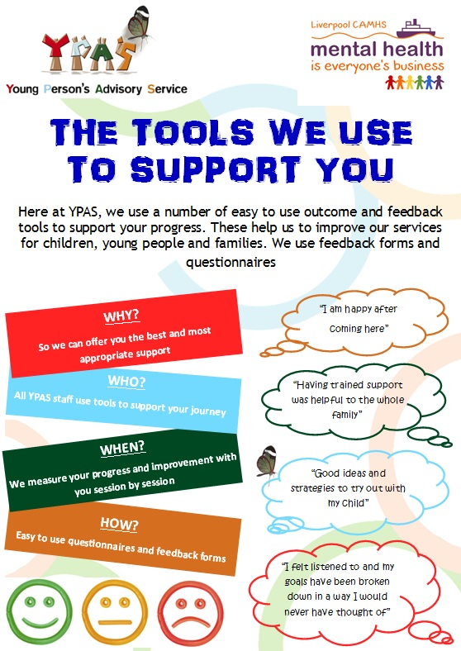
Benefits

Slide 23
Considerations
Accreditation visit
Anxiety provoking
Practitioners… “great to have the opportunity to share how we work…I surprised myself… It was empowering”
Make some noise!!
Just the beginning…

Slide 24


BROMLEY Y
TRANSFORMING MENTAL HEALTH SERVICES FOR CHILDREN AND YOUNG PEOPLE IN BROMLEY

Slide 25
BROMLEY Y
BROMLEY Y IS A THIRD SECTOR CAMH SERVICE DELIVERING A ‘NEEDS BASED’ WELLBEING SERVICE
INVOLVED IN THE CYP IAPT PROGRAMME SINCE WAVE 2
90% OF STAFF TRAINED IN A CYP IAPT MODALITY
OUTCOME MEASURES USED ROUTINELY AND AT POINT OF TRIAGE

Slide 26
OPPORTUNITIES
TO UNDERSTAND WHAT WORKS IN WHAT WE DO
TO DEMONSTRATE CYP IAPT PRINCIPLES IN ACTION
TO HAVE STAFF RECOGNISED FOR THEIR SUCCESSES
TO SHARE OUR GOOD PRACTICE
ABOVE ALL,TO LEARN TO IMPROVE ON WHAT WE ARE DOING WELL (AND WHAT WE COULD DO MORE OF/ DIFFERENTLY) WITH CHILDREN & YOUNG PEOPLE

Slide 27
PROCESS
HOW DO WE EVIDENCE GOOD PRACTICE?
HOW TO VIEW IT AS AN ORGANISATIONAL LEARNING EXPERIENCE?
HOW TO PUT LEARNING IN TO PRACTICE?
HOW TO SHARE OUR LEARNING AND SUCCESS WITH CYP AND THE WIDER SYSTEM?

Slide 28
LEARNING
GOOD PRACTICE NEEDS TO BE EVIDENCED - AND UPDATED!
INVITING CRITIQUE AS AN OPPORTUNITY FOR GROWTH ENABLES STAFF BUY IN
STANDING STILL AS A SERVICE IS NOT POSSIBLE WHEN YOU WORK WITH YOUNG PEOPLE
MAKE TIME TO CELEBRATE SUCCESS AND RECOGNISE THAT WE CAN ALWAYS DO BETTER

Slide 29

Questions?
You may wish to consider:
  It’s about the journey!
  Timescales
  Lead personnel
  Who will coordinate for the organisation
  How to ensure commitment from all teams/ staff

