Slide 1
Routine Outcome Monitoring: the good, the bad, and the ugly
Kim de Jong, PhD | CORC Member’s Forum, November 22, 2017

Slide 2
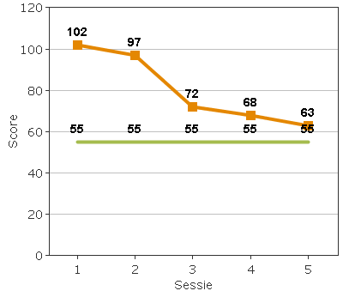
What is ROM?

Slide 3
Introduction
Research shows psychological treatments are successful: 67% of patients improve reliably
In clinical practice, results are less optimistic:
  35% improved reliably (Hansen, Lambert & Forman, 2002)
  effect sizes were 50% smaller (Barkham et al, 2008; Weisz et al., 1995)
Monitoring patients’ progress is considered a potentially effective way to improve outcomes
Notes:
So lets go back to evidence based practice. What is the evidence for psychotherapy? It is effective for most patients. There is a vast amount of evidence for that. However, in clinical practice results are not as good…

Slide 4
What is outcome measurement?

Slide 5
Not on Track

Slide 6
Signal – outcome relationship
Lutz, Lambert, Harmon, Tschitsaz, Schürch & Stulz, 2006

Slide 7
Problem patterns in NOT clients
Cluster 1 (20%) | Cluster 2 (30%) | Cluster 3 (50%)
Alliance | Life events | General elevation
Motivation | Social support
White, Lambert, Ogles, McLaughlin, Bailey & Tingey, 2015

Slide 8
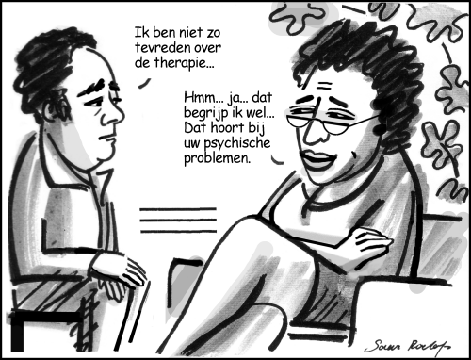
Why do we need feedback?
I’m not that satisfied with the therapy…
Hmm… yes… I understand…
That is part of your psychological problems

Slide 9
Therapists’ predictions of outcome
Final outcome was predicted for 550 clients
3 were predicted to have a negative outcome, whereas 40 had actual negative outcomes
Staff were accurate 1 time (2,5%)
Algorithms for feedback were correct 77% of the time in predicting deteriorated patients
(Hannan, Lambert, Harmon, Nielsen, Smart, Shimokawa, Sutton, 2005)

Slide 10
Do we overestimate ourselves?
Self-serving bias:
  2/3 of clinicians consider themselves to be in the top 75% of their field
  0% belief themselves to be below average
Therapy rationale:
  Do patients need to get worse before they get better?

Slide 11

Effectiveness of feedback

Slide 12
Does feedback improve outcomes?
4 meta-analyses:
  Lambert et al., 2003
  Shimokawa, Lambert, & Smart, 2010
  Knaup et al., 2009
  Kendrick et al., 2016
Mixed results, feedback seems most effective for NOT cases
All four have restrictions
Almost no moderators found

Slide 13
New meta-analysis
Most inclusive MA so far (43 studies)
Three level mixed model meta-analysis
Additional data was obtained from authors to allow for moderation analyses
High integrity:
  Bias ratings
  Independent ratings
  Independent data-extraction

Slide 14
Overall effect size = 0.17

Slide 15
Moderators
Checked for:
  Feedback characteristics (e.g. timing, type)
  Treatment characteristics (e.g. setting, duration)
  Study characteristics (e.g. country, PIs )
Only one significant moderator found:
  One feedback instrument seemed more sensitive to change than others.

Slide 16
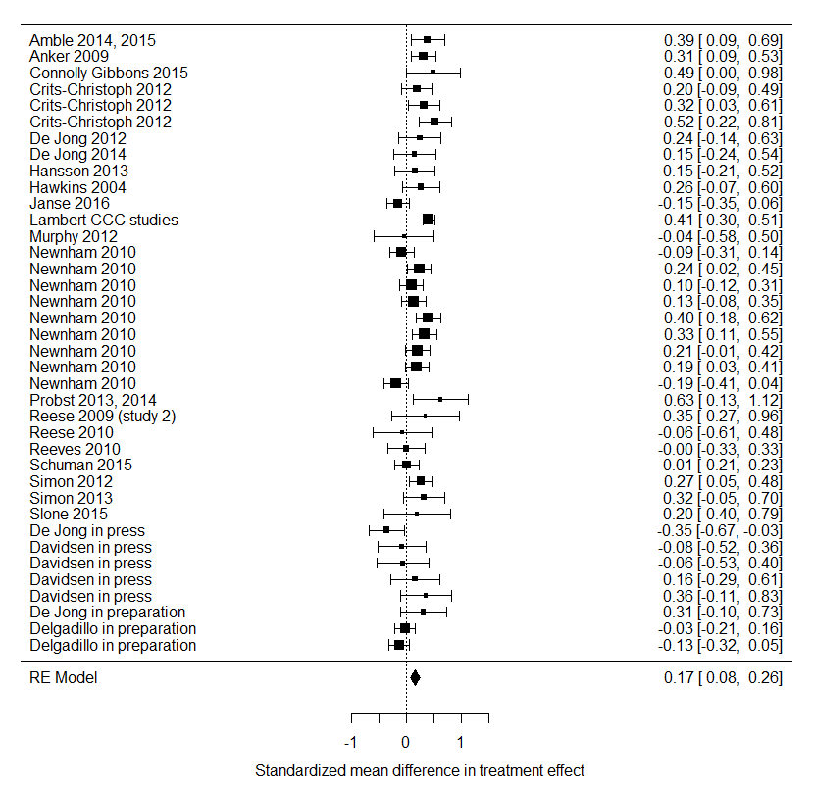
NOT cases
effect size = 0.17

Slide 17
Hypotheses
Are studies with small effects more likely to report NOT results?
Cohort studies more likely to show negative effects for NOT cases?
Where authors of large / multiple studies more likely to run additional results for NOT cases?
Better TAU in Europe/Australia?
Are NOT cases are prevented by feedback?

Slide 18

mediators

Slide 19
Active use

Slide 20
Differences between therapists
Negative feedback
3/10

Slide 21
What predicts this pattern?
Therapists who are
  Higher on prevention focus -> more trouble w NOT cases
  Lower on self-efficacy -> more trouble w NOT cases
  (de Jong et al., 2012; De Jong & De Goede, 2015)

Slide 22
Spontaneous Remitter
Easy Patient
Improvement
Pliant Patient
Challenging Patient
Intractable Patient

Slide 23
Patient complexity rating
Complexity rating, based on literature:
  Marital Status: Widowed or Divorced
  No education or only primary school
  Unemployed, long-term sick leave, disabled
  Comorbid Axis I or II disorders
  Ethnic minority of non-Western descent

Slide 24
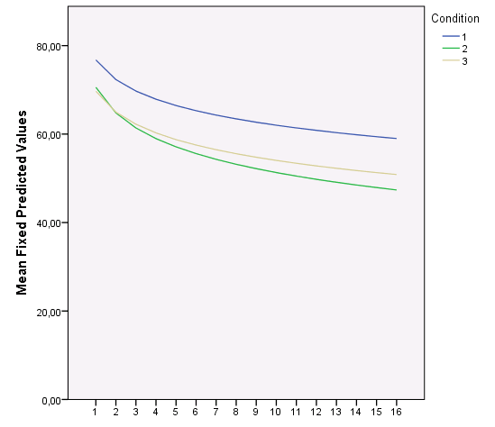
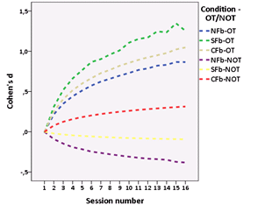
Low complexity
No Fb
ROM Fb
CST Fb
No significant effect of feedback

Slide 25
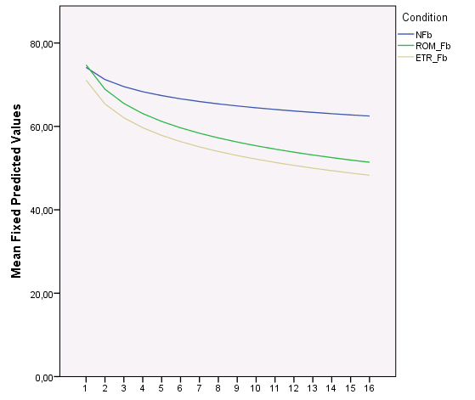
Medium high complexity
No Fb
ROM Fb
CST Fb
)^{p=0.08}
)*
Some overall effects are significant

Slide 26
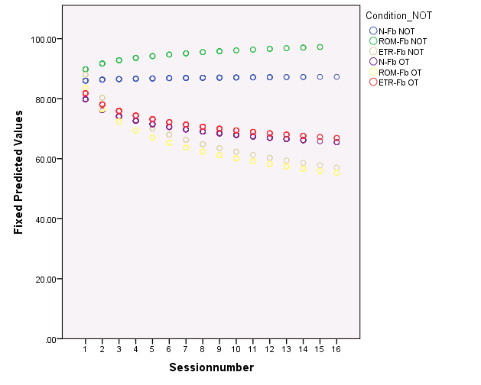
High complexity patients
o NOT-NFb
o NOT-ROM Fb
o NOT-CST Fb
o OT-Nfb
o OT-ROM Fb
o OT-CST Fb
Clinical support tools are especially helpful

Slide 27

Potential Mechanisms of action

Slide 28
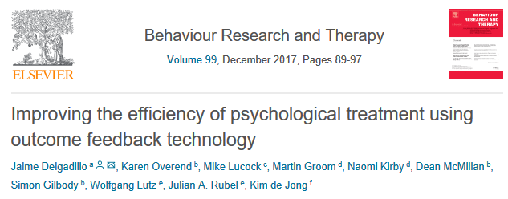
1. Attention effect

Slide 29
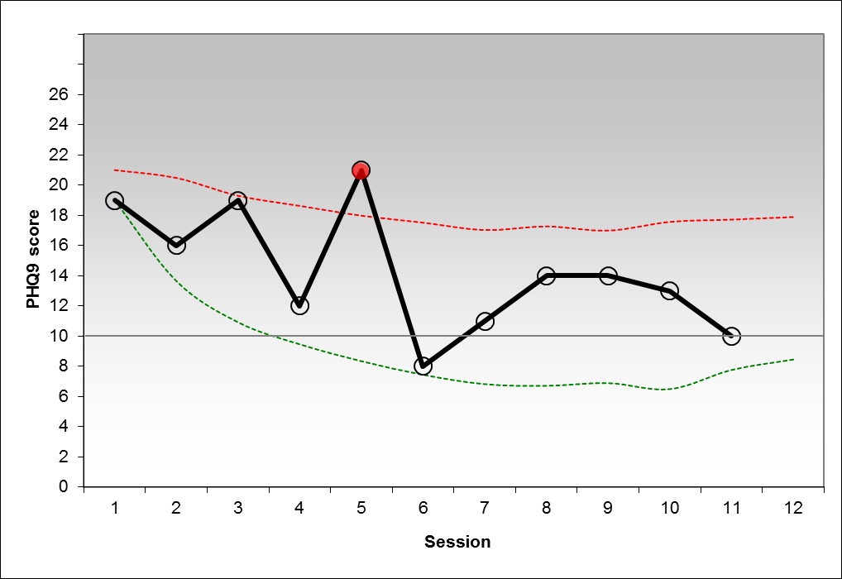
risk signal

Slide 30
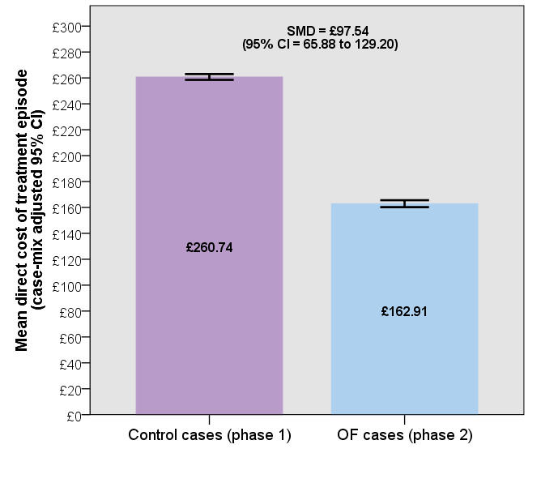
Average saving of £97.54 x 249 cases = £24,287.46
Average saving of £97.54 x 249 cases = £24,287.46

Slide 31
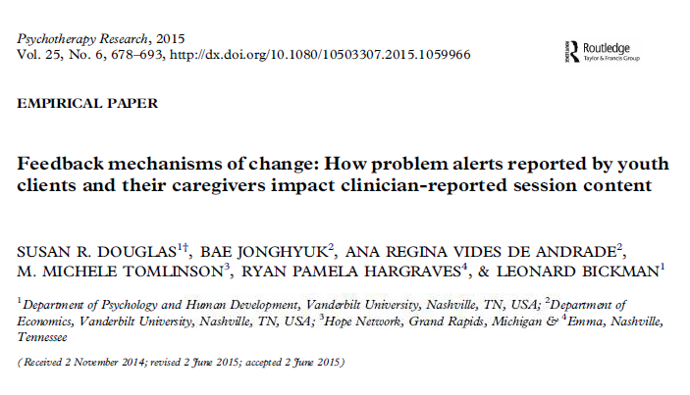
2. Filling in the blind spots

Slide 32
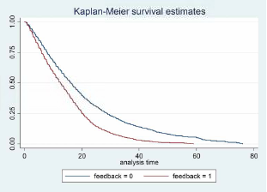

Slide 33
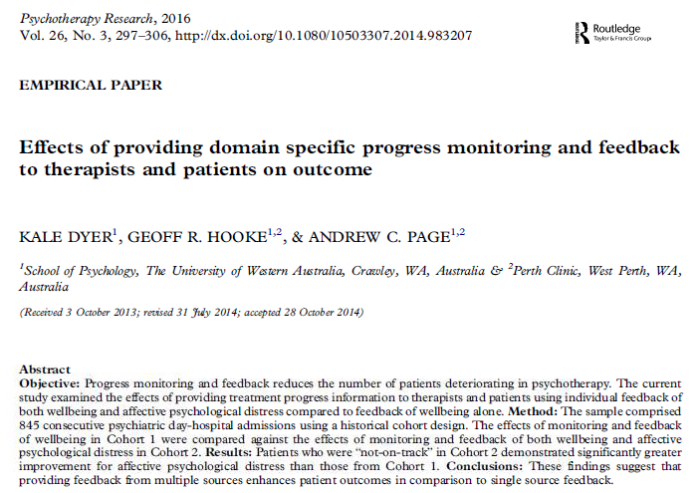

Slide 34
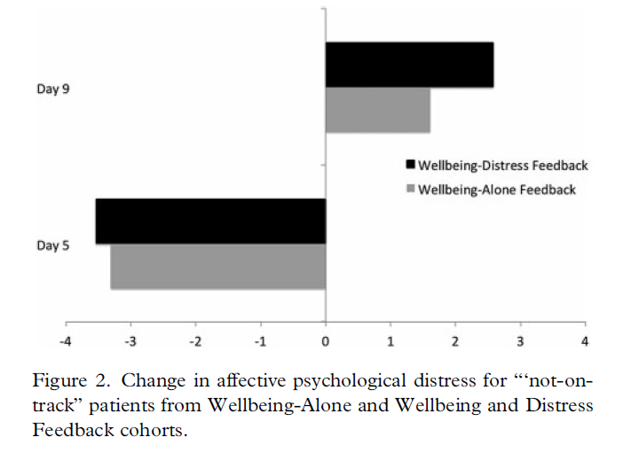
More information

Slide 35
3. Altering clinicians’ expectations
Remember that clinicians are generally poor at predicting which patients will deteriorate?
What about positive outcomes?
Would receiving information on patients’ progress alter these expectations?

Slide 36
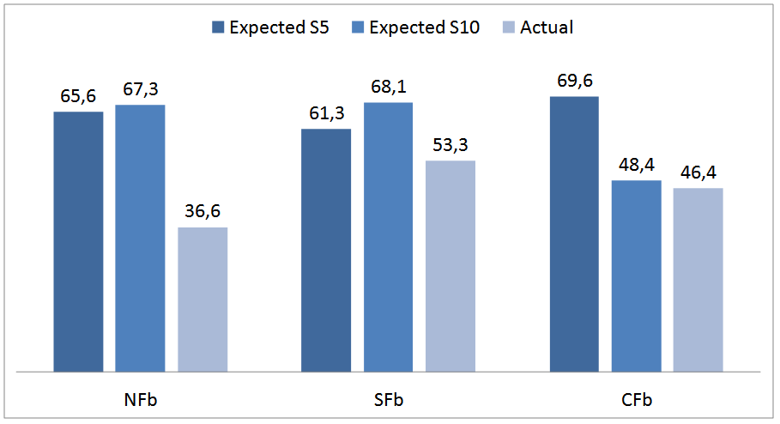

Predicting recovery
De Jong et al., in preparation

Slide 37
Feedback effect on expectancies
De Jong & Peetoom, in preparation

Slide 38
Conclusions
Overall effect of feedback is small (es=0.17), but seems robust
Still much we don’t know about how and why feedback works:
  No moderating variables found so far
  Attention effect?
  Changing the expectation of the therapist?
  Mechanism(s) of action still largely unclear

Slide 39

Questions
www.kimdejong.net
Follow me on twitter: kdej_psyres

Slide 40

How does feedback work?
Expectancy
Attitude
Self-Efficacy
Regulatory
focus
Goal
Self-change
Improved
outcome
Emotion
regulation
Negative
Feedback
Self-
protection
Decreased
outcome

