Slide 1
Should mental health services seek to cure mental ill health?
If not, what are they there for?
CORC Regional Seminar Series

Slide 2
Plan for the afternoon
2:00pm | Welcome and introductions
2:05pm | Learning from CORC data Rates of improvement following care for anxiety and depression Comparing outcomes for those children seen by services with those not seen by services Q&A
2.25pm | What impact does routine treatment have on clinical outcomes for children and young people with anxiety and/ or depression?: a review of the research
2.45pm | Panel member reflections and discussion with the floor
3.05pm | Framing a public health response to mental health: learning from obesity
3.25pm | Roundtable discussion: what are the implications for services?
3.55pm | Panel-led discussion
4.15pm | Further research, next steps and closing comments
4:30pm | Event close

Slide 3
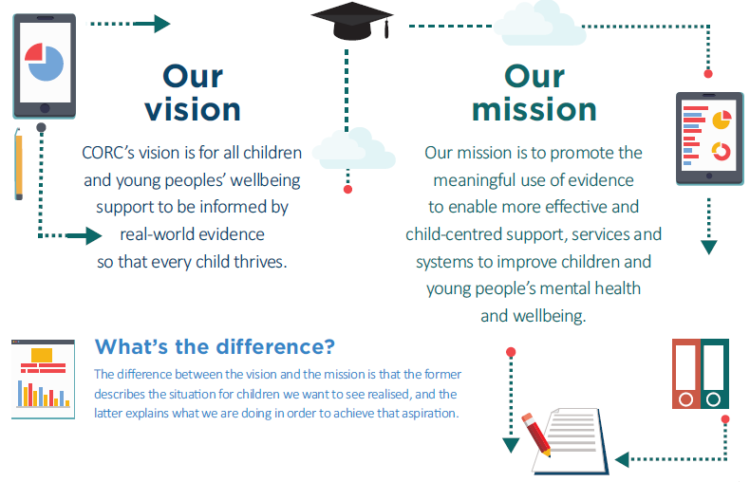
Who we are
CORC is the UK’s leading membership organisation that collects and uses evidence to improve children and young people’s mental health and wellbeing
www.corc.uk.net

Slide 4
Who we are
Please log into our mentimeter for today
www.menti.com
33 56 92
#CORCSeminar
@CORCcentral

Slide 5
Considering cure in CORC and allied data - Rates of improvement following treatment and comparing treated and untreated children: complexities and challenges of our and others’ findings
Prof Miranda Wolpert, Director of CORC
Ben Ritchie, CORC Informatics Lead
Notes:
There is evidence of increasing levels of anxiety and depression in adolescents internationally,¹⁻⁷ leading to much emphasis on the need for more treatment access. However, there is much less discussion or evidence as to how many are substantially better following treatment.
There is an urgent need to determine how effectively current services address burgeoning numbers of adolescents with anxiety and depression.

Slide 6
Public discourse about CYPMH currently
Don’t normally talk about “cure”
Do often stress treatability:
“Like other medical conditions, anxiety disorders tend to be chronic unless properly treated. Most kids find that they need professional guidance to successfully manage and overcome their anxiety.”
Website of the Anxiety and Depression Association of America
Notes:
NICE guidance don’t give prognostic rates e.g. how many will be improved following treatment and how many not
In physical health this more openly talked about e.g. some sorts of leukaemia 30% cure rate and for diabetes national audit has shown an increase from 14% to 24% of children being within the normal limits for control of their blood sugar.
Do these conversations happen in MH if so how do they happen and what sort of prognostic figures do people give?

Slide 7
Trying to work out the impact of treatment is challenging
How do we define a good outcome?
What metrics are appropriate?
change? recovery?
at what time point?
How do we disentangle the impact of services, given normal fluctuations in mental health problems?
How can we identify a natural control group for children attending child and adolescent mental health services?

Slide 8
FUPS data
Flawed
Uncertain
Proximate
Sparse

Slide 9
Learning from other studies

Slide 10
Learning from cohort data
Schaefer, J. D., Caspi, A., Belsky, D. W., Harrington, H., Houts, R., Horwood, L. J., & Moffitt, T. E. (2017). Enduring mental health: Prevalence and prediction. Journal of abnormal psychology, 126(2), 212.
Based on life course trajectories for mental health over a 30 year period. Involved six sweeps of data (988 people, 5-38 years old in NZ)
17% enduring positive mental health
41% had mental health problems at only one or two sweeps
41% had mental health problems at more than 3 sweeps

Slide 11
Learning from remission rates
Whiteford HA, Harris MG, McKeon G, Baxter A, Pennell C, Barendregt JJ, et al. Estimating remission from untreated major depression: a systematic review and meta-analysis. Psychological medicine. 2013;43(8):1569-85.
Using a waitlist control may artificially inflate the perceived impact of treatment
Spontaneous rates of remission for young people were around 48%
Compared to adults, children and adolescents were more likely to achieve remission without treatment, and to achieve it faster.

Slide 12
Learning from RCTs
Weisz JR, Kuppens S, Ng MY, Eckshtain D, Ugueto AM, Vaughn-Coaxum R, et al. What five decades of research tells us about the effects of youth psychological therapy: A multilevel meta-analysis and implications for science and practice. American Psychologist. 2017;72(2):79-117.
There were statistically moderate gains from specific manualised treatments when compared to waitlist controls
The gains were less when a specific manualised treatment was compared treatment to routine care (treatment as usual)
Notes:
A recent meta-analysis of 50 years of research into treatment efficacy and effectiveness for child and adolescent anxiety and depression found overall statistically moderate gains from treatment in trials when compared to waitlist controls (Hedges’ g = 0.53), but found less difference when compared to routine care (Hedges’ g = 0.30), particularly for depression.⁸
The meta-analysis highlighted differences in perspective between the adolescents, parent/carers and clinicians, and commented on the need to consider the impact of routine care and to consider these perspectives independently.
Outcomes were all reported in terms of effect size differences between treatments and not in terms of individual-level improvement rates, as has been the traditional focus in psychotherapy outcome research. More recently this has been critiqued as potentially leading to over-inflated estimates of impact for a given individual as it does not include any consideration of clinically meaningful metrics of change, nor does it take into account differences between individuals in terms of outcomes.⁹
A review of child mental health research found only five studies which examined self-reported reliable improvement following exposure to routine care for young people with anxiety and/or depression. These have all been undertaken in the US, Australia or Scandinavia and employed small samples (N = 11–85 adolescents) and report low rates of reliable improvement (8–36%) with 0–10% deterioration (see Table 3).
Literature has focused on differences between treatments rather than individual-level improvement rates and on clinician or carer perspectives.
This gap in the literature about adolescent-rated rates of improvement following care limits practitioners and others being able to set realistic expectations for outcomes.

Slide 13
Learning from prospective data
Neufeld SA, Dunn VJ, Jones PB, Croudace TJ, Goodyer IM. Reduction in adolescent depression after contact with mental health services: a longitudinal cohort study in the UK. The Lancet Psychiatry. 2017.
Based on a sample of depressed UK adolescents
Compared those who had contact with help (GP, community and specialist services) with a ‘no treatment’ sample
Outcomes were not distinguishable at 1 year follow up
At 2 year follow up, both groups were below the clinical threshold. Those who had received help were not statistically distinguishable from those that had no problems in the first place.

Slide 14
Learning from CORC analysis CYP IAPT data
Wolpert, M., Jacob, J., Napoleone, E., Whale, A., Calderon, A., Edbrooke-Childs, J. (2016). Child- and Parent-reported Outcomes and Experience from Child and Young People’s Mental Health Services 2011–2015”. London, CAMHS Press.
Indicator | N | % of paired clinical sample (95% Margin of Error)
Recovery | 2117 | 36% (35% - 37%)
Reliable improvement | 3056 | 52% (51% - 53%
No reliable change | 2223 | 38% (36% - 39%)
Reliable deterioration | 617 | 11% (9% – 12%)
Reliable recovery | 1569 | 27% (25% - 28%)

Slide 15
Learning from further analysis CORC data
1) Considering reliable improvement in depression and anxiety in CYP IAPT data- paper invited to resubmit with some amends
2) Comparison of treated and untreated children using two separate dataset (school and CORC)- rejected by reviewers

Slide 16
So should mental health services seek to cure mental ill health? If not - what are they there for?
For some will be cure but not for all
May be about focussing on how treatment can enhance adolescents’ ability to manage ongoing symptoms and difficulties many of which may still likely to be present at the close of treatment.
May be about balancing hope and realism
Notes:
Returning to central question
We're concluding from our understanding of the data that for some children difficulties will go completely
For many there may be enduring difficulties, or difficulties that come and go
And it may be that the focus should be on how treatments can enhance adolescent's ability to manage ongoing symptoms and difficulties
And it may be that our focus as a community should be on how best we can balance hope and realism

Slide 17
Any immediate questions?
Learning from CORC data Rates of improvement following care for anxiety and depression
Learning from CORC data Rates of improvement following care for anxiety and depression

Slide 18
What impact does routine treatment have on clinical outcomes for children and young people with anxiety and/ or depression?: a review of the research
Please note we are not currently in a position to distribute these slides as Holly Bear’s PhD research is pre-publication.
We will be sharing these findings on the CORC website in due course. Please do keep an eye on our newsletter and twitter feed where we will be flagging this to members of CORC and our wider Network.

Slide 19
Panel response and discussion

Slide 20
Framing a public health response to mental health: learning from obesity
Prof Miranda Wolpert, Director of Child Outcomes Research Consortium (CORC)
Kate Dazell , CORC Practice Lead

Slide 21
Learning from Obesity
Wolpert, M. (2018). Rethinking public mental health: learning from obesity. The Lancet Psychiatry.
Considers book on “Models of Obesity” by Ulijaszek (2017)
Suggests 5 key steps to progress public mental health for CYP

Slide 22
5 steps to Public Mental Heath for CYP
Conceive of CYPMH as relapse-remitting
Agree a standard metric of measurement
Map the complex combination of factors that contribute to the public health problem
Adopt a “poly-rational approach”
Seek “viable clumsy solutions”

Slide 23
Step 1: Agree conception of MH problems
Conceive of CYPMH problems as broadly relapse-remitting
Many still have problems at the end of treatment (Wolpert et al 2016)
Many problems get better by themselves but may then later relapse
(Whiteford et al 2017, Neufeld et al 2017)
Most people will have problems at stages over their life time (Schaefer et al 2017)
Many people still have ongoing problems but manage in life (Rutter 2016)
May need in time to focus on being clearer what issues most likely acute and which chronic

Slide 24
Step 2: Agree a standard metric
“Standardization of obesity measurement using BMI has allowed sense to be made of population obesity more easily through the practice of epidemiology.”
Need to
be clear what we mean by mental health or the lack of it.
stop using mental illness, distress, poor wellbeing interchangeably
Agree measure of positive change e.g. reliable improvement or recovery
Notes:
Who uses measures

Slide 25
Step 3: Map the psychopathogenic system
“Obesogenic environments are easily identiﬁed by a … preponderance of motorized transport and of sedentary occupations, and the cheap and easy availability of high-fat, high-reﬁned-carbohydrate foods” Ulijaszek
Need to rigorously consider elements of psychopathogenic environments for MH:
Poverty
Social isolation
Bullying
What is the role of current configuration of services?

Slide 26
Step 3 Note 1: beware one answer solutions
Parents: Kids are more depressed these days, I wonder why?
Kids: You destroyed the economy for us, the earth is literally dying, we are going to work until we die and on top of that the Nazis are back.
Parents: It's those pesky iPhones
@panoparker tweet 3rd Dec 2017

Slide 27
Step 3 Note 2: beware the blame game
In societies promoting individualist values, obesity regulation is often synonymous with individual self-control.
Models focus on responsibilization and self-management, and on parents and schools for the prevention and reduction. Ulijaszek
Don’t focus on idea that children must develop grit” or “resilience”.
Don’t blame parents
Consider full environment as well as individual variation

Slide 28
Step 4: Adopt a “poly-rational approach”
“Different forms of rationality carry different meanings according to discipline, be it economics, psychology, sociology, evolutionary biology or political science”. Ulijaszek
Note power structures and vested interest
Beware over-reliance on biomedical: equal status for different disciplines
Consider non hierarchical frameworks, to draw on different types of evidence to inform action:
observational, experimental, extrapolated, experience based

Slide 29
Step 5: seek “viable clumsy solutions”
Cross discipline and cross government attempts may be multiple and uncoordinated- leading to “cacophony of effort”
Accept no one neat rational solution likely to solve things
Bring key stakeholders together to consider physical, economic, policy, socio-cultural and environmental factors
Trial a set of viable clumsy solutions, using agreed metrics to consider outcomes

Slide 30
Roundtable discussion
What has been seems important to you, or has been of particular interest, in what has been discussed today?
What would be the right kind of metric?
For understanding the impact of services
For informing a public mental health approach
Who needs to be in this conversation - and how do we get them here?

Slide 31
Thank you for attending
We would be grateful for your feedback
Visit menti.com and use code 39 11 72
to fill out our evaluation form
Thank you for attending the seminar

